Slide 1
Cambridge
IGCSE
Computer Science
Paper 1
Barcode readers, scanners and cameras
Unit 3: Input and output devices
1

Slide 2
Objectives:
Describe the principles of operation of the following manual input devices:
Keyboards and keypads
Pointing devices (mouse and trackerball)
Microphones
Touch screens (including tablets and mobile phones)
Interactive Whiteboards
Describe how these principles are applied to real-life scenarios

Slide 3
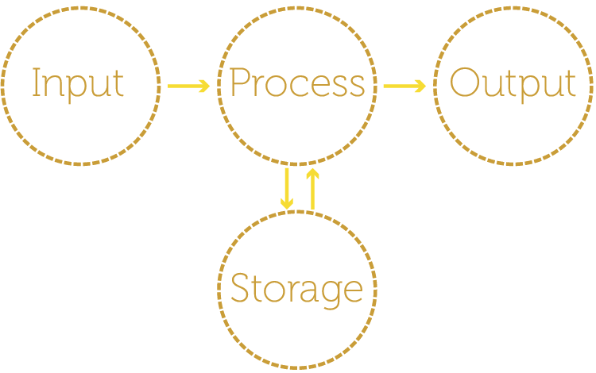
Inputs and outputs

Slide 4
Input devices
Input devices transfer data from the source in the outside world to the computer
Some input devices require greater human intervention than scanners or cameras to generate the data. These include:
Keyboards and keypads
Pointing devices
Microphones
Touch screens
Interactive Whiteboards

Slide 5
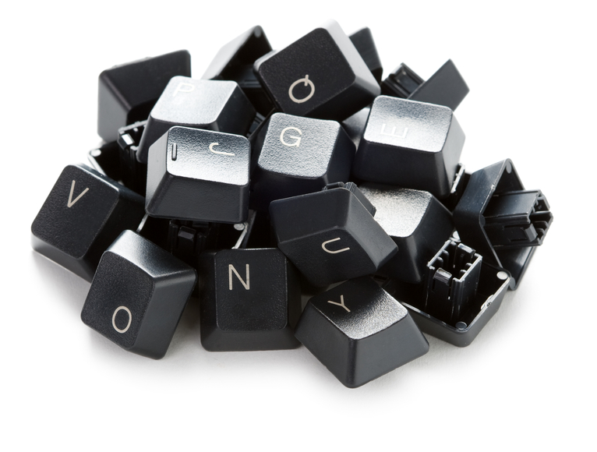
Keyboards and keypads
A key is made from plastic and has a small peg underneath which fits exactly into a hole in the keyboard when it is pressed
A small piece of rubber under the key makes it bounce back up so that it is ready to be pressed again

Slide 6
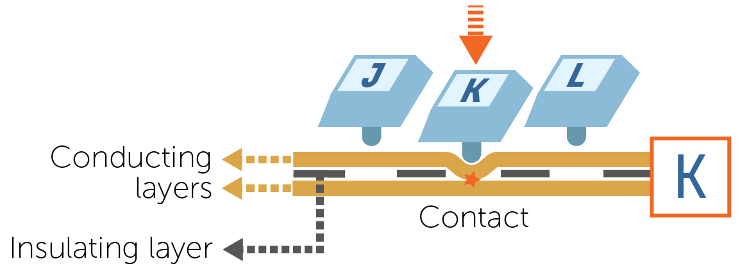
How a keyboard/keypad works
When a key is pressed, the small bar under the key pushes through a small hole and makes contact with a conducting membrane
Here, the letter K is pressed:

Slide 7
Keyboards
Most common method of data entry
Very simple to use
Can be connected to a computer through USB or wirelessly
Quite a slow method of data entry compared to speech, particularly if person is not trained
Frequent use of keyboards can lead to health problems like RSI (Repetitive Strain Injury) in hands and wrist.

Slide 8
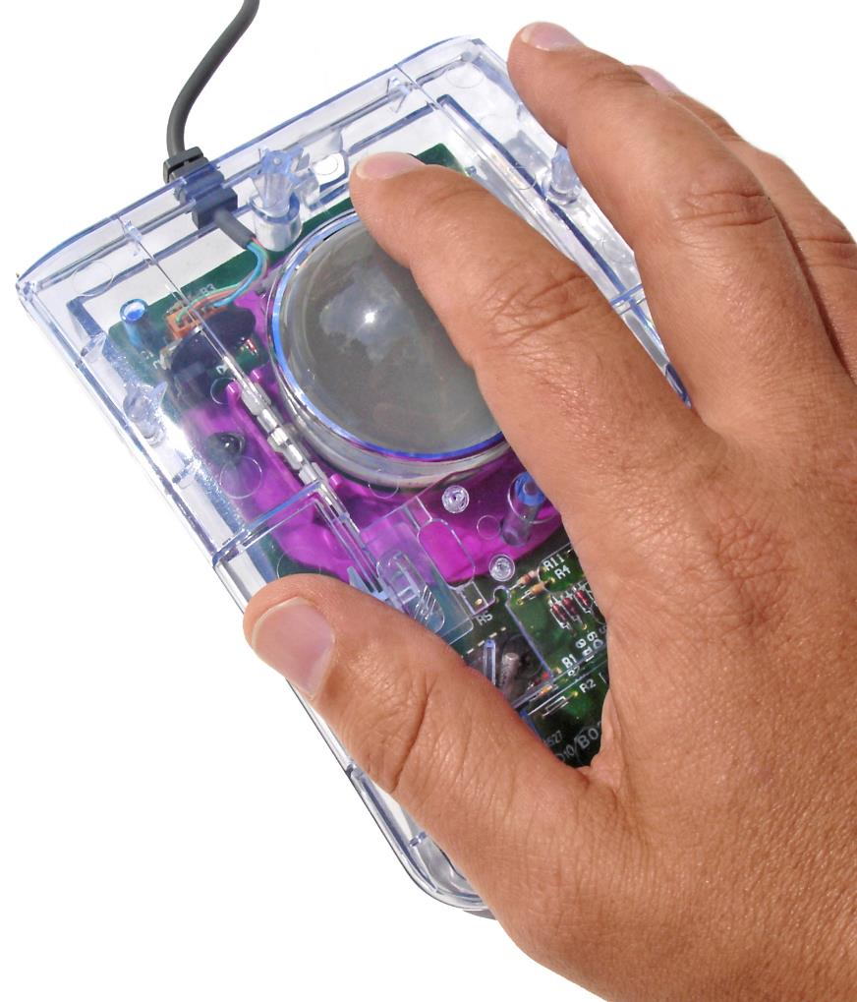
Pointing devices
Most common examples are the mouse and touchpad
Trackerballs have a ball on the top of the device which is moved by the user
The actual device itself remains stationary, thus requiring less desk space

Slide 9
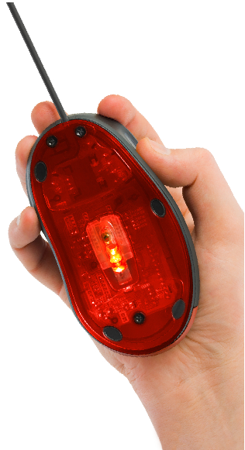
The humble mouse
A computer mouse can be mechanical or optical
A mechanical mouse uses a rubber ball underneath the mouse which moves around on a hard surface
Sensors detect the movement of the ball and send signals to the screen
An optical mouse uses a red LED and a sensor to determine the movement of the mouse
All devices, including the trackball can be connected to a device via a USB port or using a wireless connection

Slide 10
Pointing devices
Mice require an area of desk space to allow movement
A dirty surface may cause problems with the operation of the mouse, especially one with a ball
Trackerballs can be used in places where there is not very much desk space
The user is less likely to suffer from RSI using a trackerball, than a mouse
Touchpads are now used with laptops, meaning extras (like a mouse) do not also need to be carried about

Slide 11
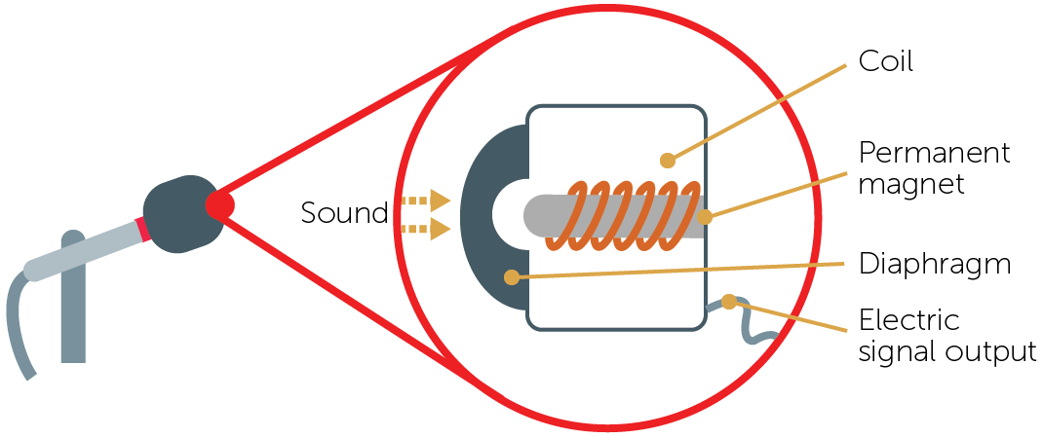
Microphones
When sound reaches the microphone, the diaphragm vibrates backwards and forwards
This causes the coil to vibrate which then changes the magnetic field produced by the magnet
Changes in current are detected and a signal is output

Slide 12
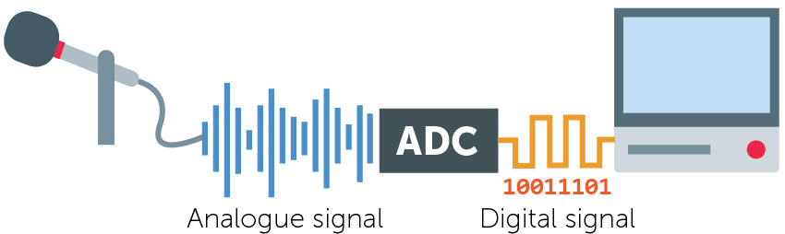
Analogue to digital conversion
The output from the microphone is analogue
This analogue signal needs to be converted into a digital signal so the computer can understand the data
How might a speaker operate?

Slide 13
Microphones
Microphones are either built into the computer, or connected wirelessly or through USB
Speech recognition systems can allow for faster data entry than keyboards and are very useful in situations where it is difficult to type and for physically disabled people
Problems can occur in noisy environments where sound cannot be recorded clearly
Voice recognition systems, allow for individual users to be identified, and so are often used in security systems

Slide 14
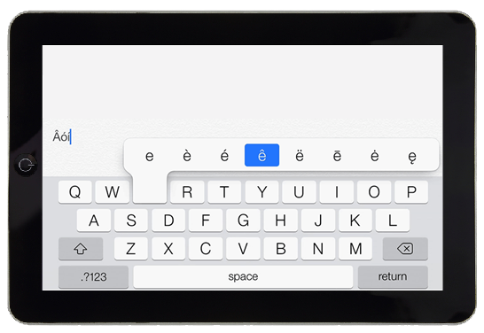
Worksheet 2
Now complete Task 1 on Worksheet 2

Slide 15
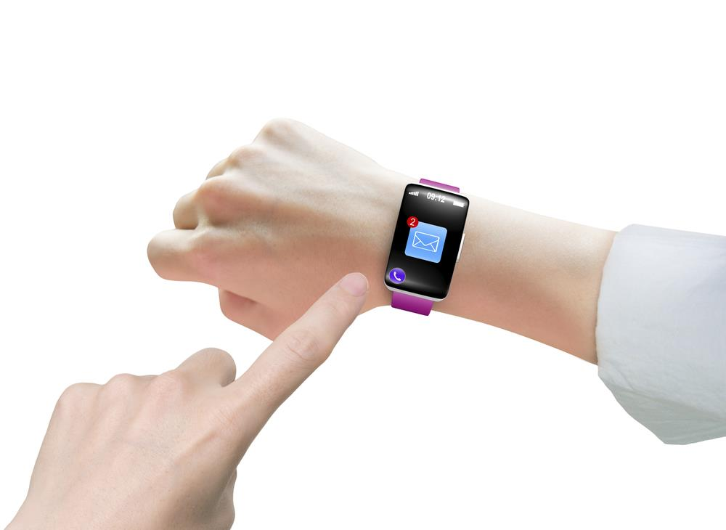
Touchscreens
Three common touchscreen technologies are used with tablets, watches and mobile phones:
Resistive
Capacitive
Infrared

Slide 16
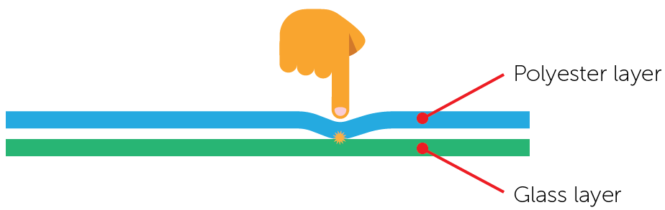
Resistive touchscreens
Resistive touchscreens are made up of a layer of conductive polyester and a layer of conductive glass
The two layers are separated by an insulating spacers / membrane
When the screen is pressed by a finger, the two conducting layers make contact and complete a circuit
The position where the screen is touched is calculated by a microprocessor

Slide 17
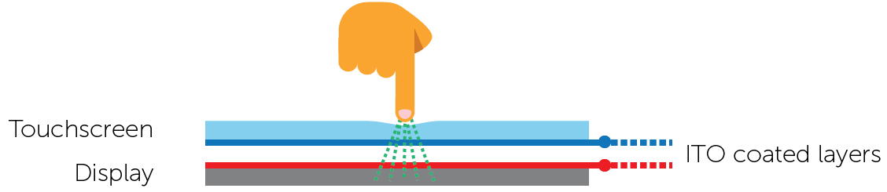
Capacitive touchscreens
Capacitive touchscreens are made up of glass layers
The bottom surface of the upper layer and top surface of the bottom layer are coated in perpendicular lines of transparent conductive material (Indium Tin Oxide) forming a grid
The screen behaves like a capacitor, storing electrical energy
The screen can be touched in more than one place at a time

Slide 18
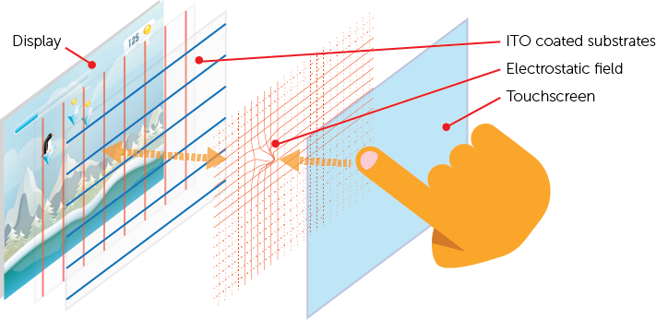
Detecting touch
When the screen is touched by a finger, there is a change in the electric field / charge at that position
The position where the field changes is calculated by a microprocessor

Slide 19
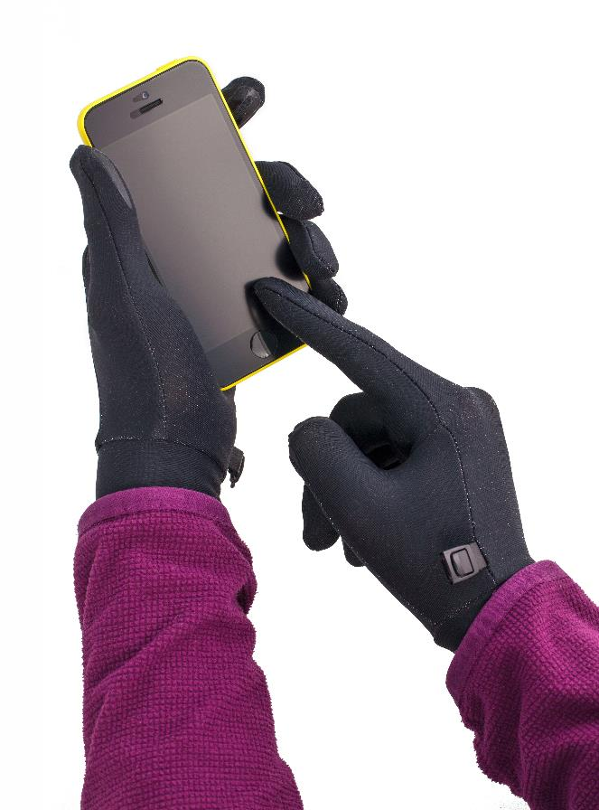
Capacitive touchscreens
Every touchscreen phone manufactured in the last few years uses the capacitive touchscreen
What happens when it’s cold outside and you are wearing gloves?
Most fabrics do not allow the current to pass through – they are not conductive
You can buy special touchscreen gloves using conductive material in the fingertips

Slide 20
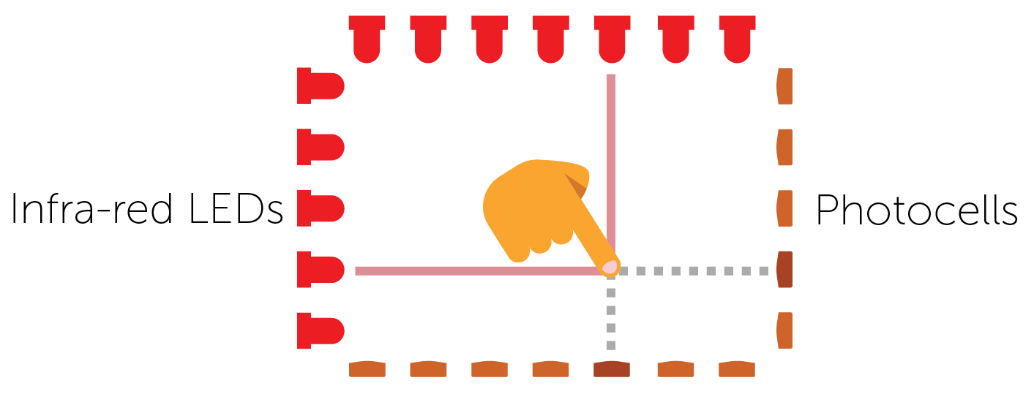
Infra-red touchscreens
LEDs shine infra-red light across the screen from the edges
The infra-red rays form a grid across the screen
When the screen is touched by a finger, the infra-red beam is interrupted
A microprocessor calculates the coordinates of where the screen was touched

Slide 21
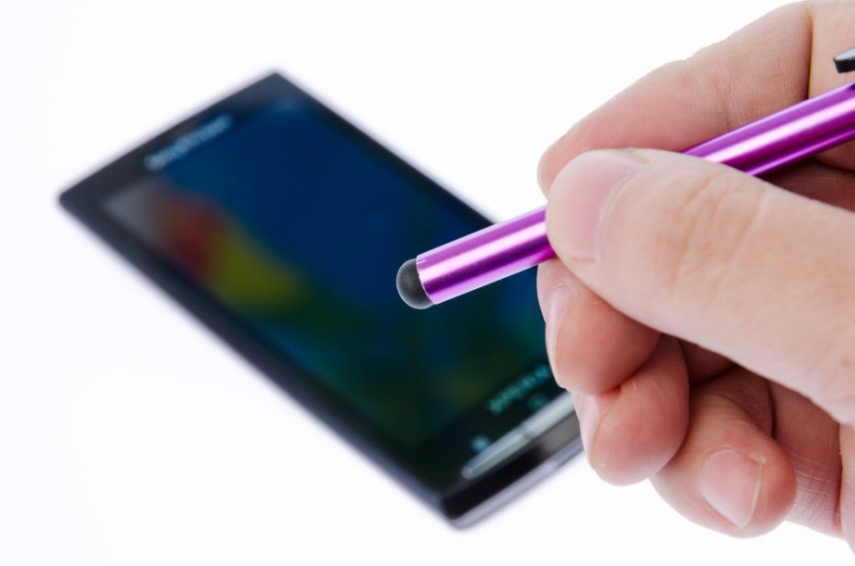
Worksheet 2
Complete Task 2 of Worksheet 2
How might this touch screen stylus pen work?

